Slide 1
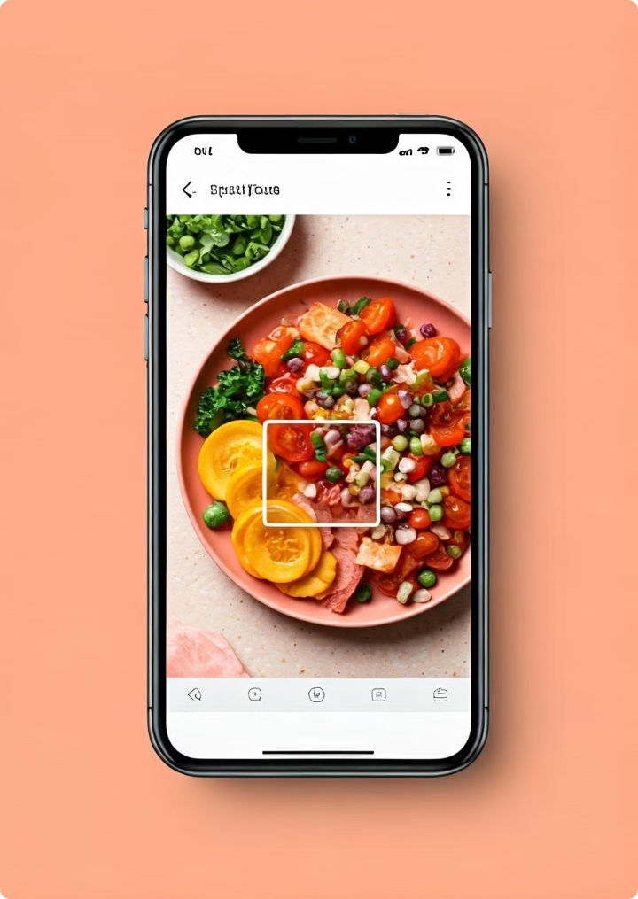


Food Recognition App
Unlock the power of food insights with our intelligent food recognition app.

Slide 2



Identify Food in Real-Time
Capture a Photo
AI-Powered Recognition
Accurate Identification
Simply point your camera at your meal and snap a photo.
Our advanced AI instantly analyzes the image to identify the food.
Get precise results, even for complex dishes with multiple ingredients.

Slide 3
Analyze Calorie Content
Calorie Counting Made Easy
Accurate Calorie Estimates
Personalized Recommendations
Stay on track with your daily calorie goals by effortlessly tracking your food intake.
Our app provides reliable calorie estimates based on a comprehensive database of foods.
Get tailored calorie recommendations based on your individual dietary needs and goals.

Slide 4
Provide Nutritional Information
Macronutrients
Vitamins and Minerals
Fiber Content
Understand the breakdown of protein, carbohydrates, and fats in your food.
Get insights into the essential vitamins and minerals present in your meal.
Track your fiber intake to support digestive health and overall well-being.

Slide 5
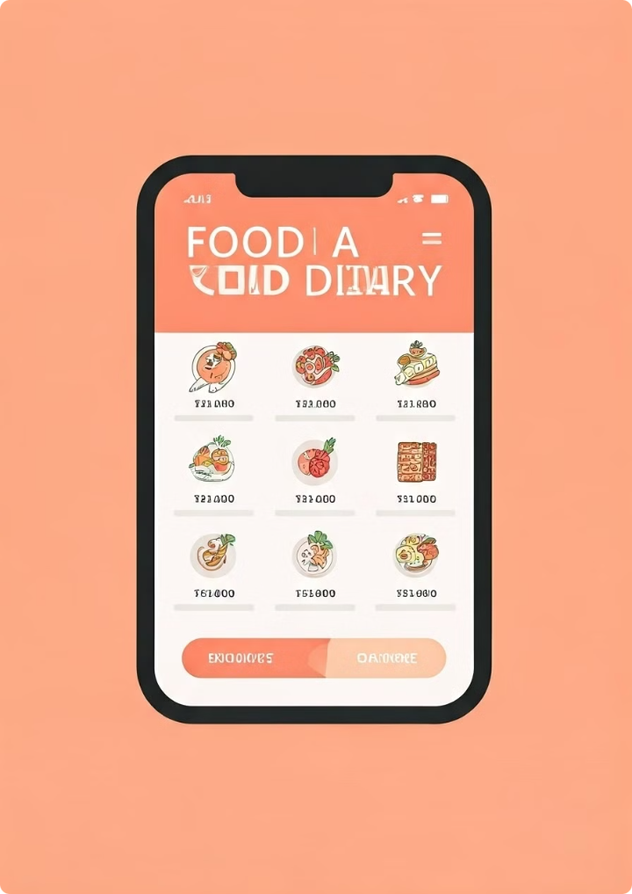
Track Daily Food Intake
1
Meal Logging
Effortlessly log your meals with our convenient food recognition feature.
2
Detailed Food Records
Keep track of your daily food intake with a comprehensive meal history.
3
Progress Tracking
Monitor your calorie intake and macronutrient distribution over time.

Slide 6

Set Personalized Health Goals
Weight Loss
Weight Maintenance
Specific Nutrient Targets

Slide 7



Share Meals with Friends
Share Your Meals
Connect with Others
Stay Motivated
Share your delicious creations with friends and family.
Engage in healthy food discussions and exchange meal ideas.
Inspire and motivate each other on your health journeys.

